Slide 1
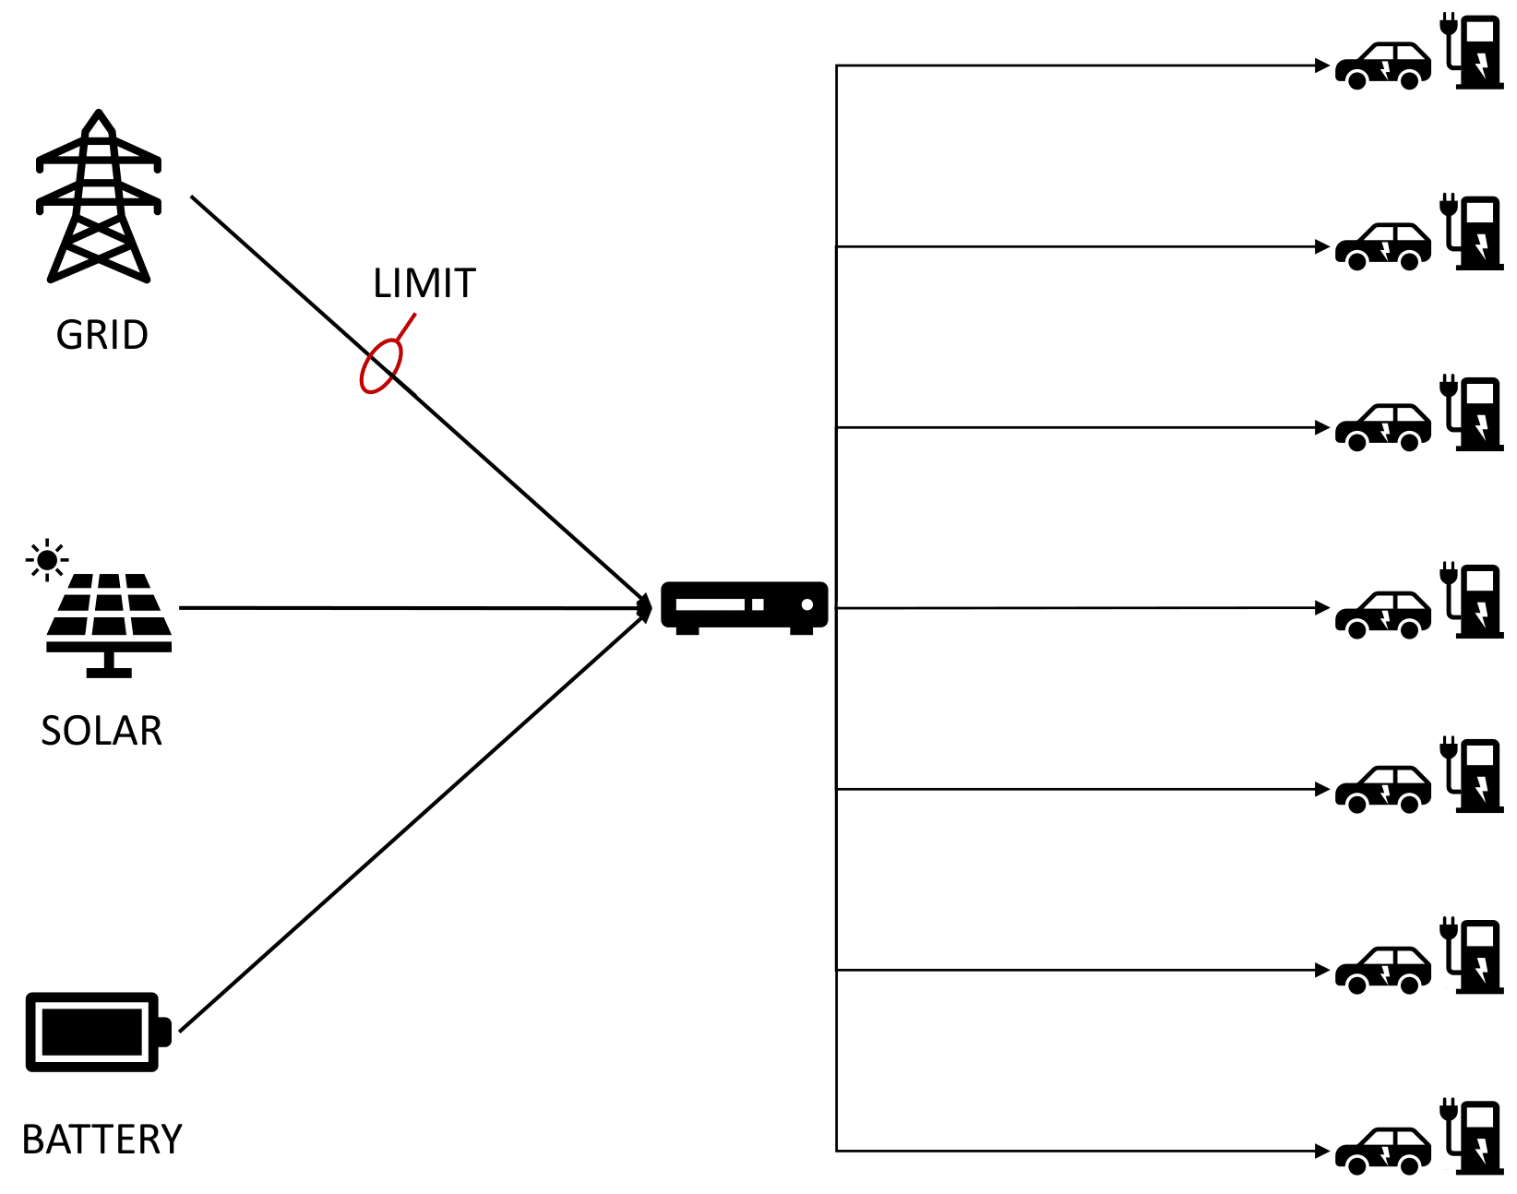
Electric Grid Analysis

Slide 2
Overall direction
Replicate grid behavior with a model
Compare two different approaches:
Logic Tensor Networks
Deep Neural Network
Focus on deeper explainability
Rule satisfaction and potential rule-enhanced learning
Focus on accuracy
Explainability with post-hoc methods
SHAP
Counterfactual

Slide 3
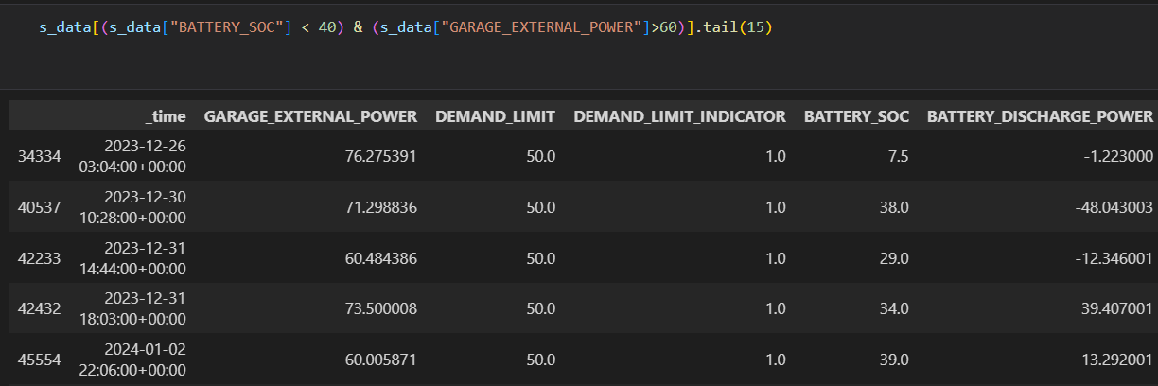
Dataset Exploration
Comparison with Ground Truth rules:
Limited dataset (no instances above 80%)
Battery doesn’t operate at full capacity
Still providing power at SOC < 15%
Overall ~16% compliance

Slide 4
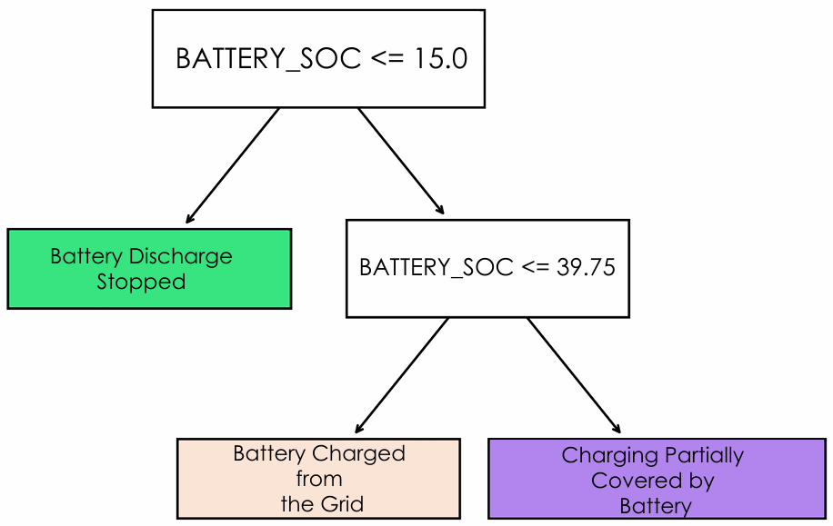
Baseline Models
Shallow decision trees
Trained on the entire dataset and cleaned subset
Extracted thresholds agree with ground truths
Interesting: Bootstrapping reveals important features
Fast-charger power
Solar power (time of day)

Slide 5
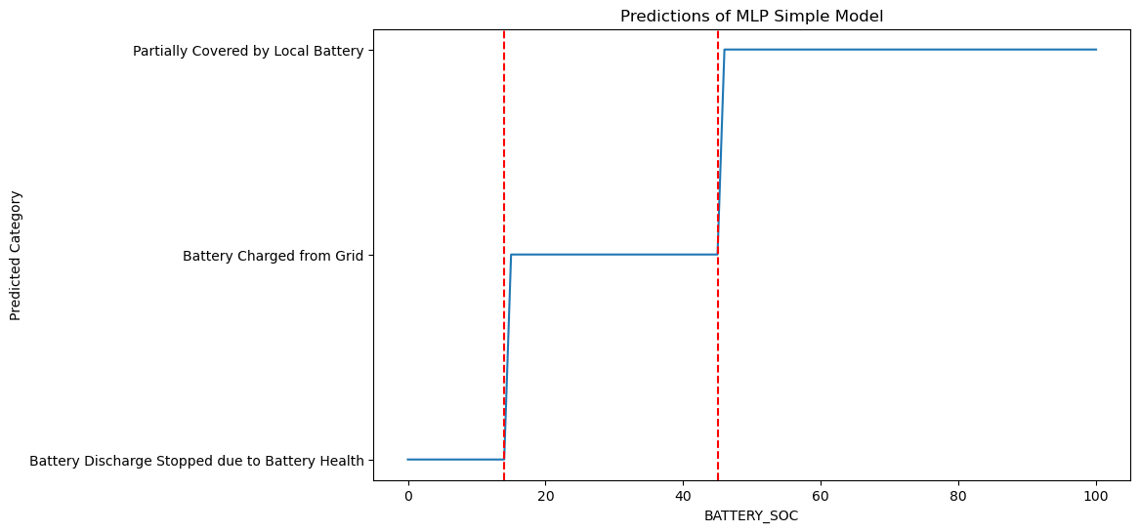
Neural Network Approach
Poor generalization of baseline model to the entire dataset – 13%
Fully connected MLP (100, 52, 52)
Improved thresholds with better performance ~80% accuracy

Slide 6
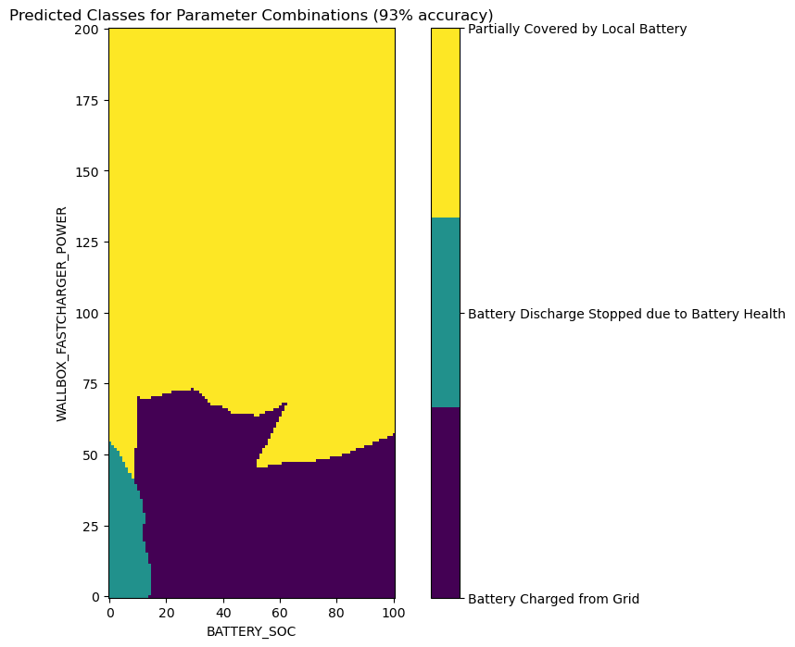
Neural Network Approach
Poor generalization of baseline model to the entire dataset – 13%
Fully connected MLP (100, 52, 52)
Two parameter model generalizes with 93% accuracy

Slide 7
LTN Approach

